Slide 1
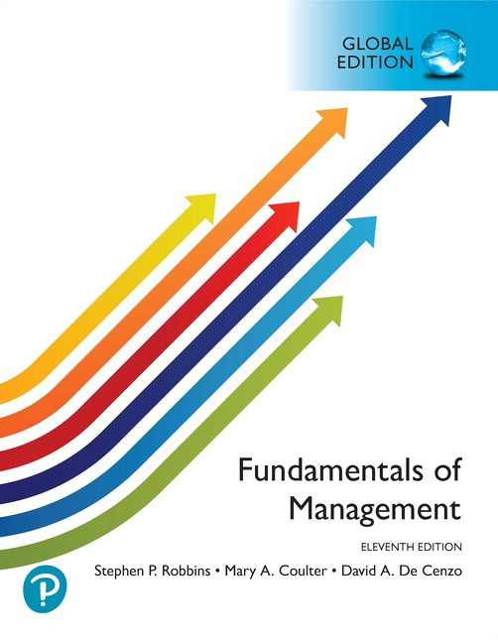
現代管理學 ch1 管理者與管理
1-<number>

Slide 2
2
Managers as Decision Makers

Slide 3
Learning Objectives
Describe the decision-making process.
Explain three approaches managers can use to make decisions.
Describe types of decisions and the decision-making conditions managers face.
Discuss group decision making.
Contemporary issues in managerial decision making.
4-<number>

Slide 4
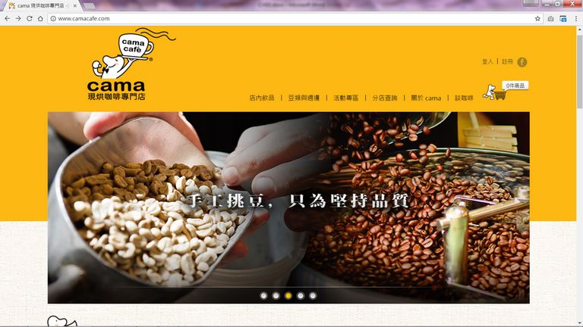
Rise of cama Café: An Unexpected Success in the Coffee Market
「現烘、平價、外帶」是cama咖啡的產品定位，目標客群則鎖定在上班族。cama咖啡的品牌精神包括精心手選、頂級技術、新鮮烘培、隨時享受，簡單說明了cama咖啡的好品質與方便性。（圖片來源：cama官網）

Slide 5

A. How Do Managers Make Decisions?
Decision: Choosing Among Alternatives
Decision making (決策制定) is often described as “choosing among alternatives.” However, this view is overly simplistic.
Decision making is actually a process—not merely a single act of selecting among options.
Decision making lies at the heart of managerial activities; indeed, “decision making is the essence of management.”
4-<number>

Slide 6
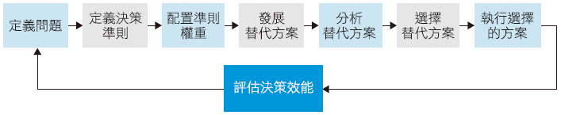
How Do Managers Make Decisions?
The decision-making process (決策制定過程) consists of eight steps, beginning with problem identification.
Decision-Making process
4-<number>

Slide 7


The Decision-Making Process
Step 1: Identify the Problem
  A problem exists when there is a gap between the current situation and the desired state. Be careful not to confuse the problem itself(問題) with its symptoms(問題的徵兆).
Step 2: Identify Decision Criteria
  Determine which factors(因素) are important or relevant to the decision.
1-<number>

Slide 8


  Step 3: Allocate weights to Criteria
  Step 4: Develop Alternatives
    List all feasible alternatives(可行方案) without evaluating them at this stage.
1-<number>

Slide 9
Step 5: Analyze Alternatives
  Evaluate each potential alternative.
Step 6: Select an Alternative
  Choose the best alternative—the one with the highest total weighted score.
1-<number>

Slide 10
Step 7: Implement the Alternative
Step 8: Evaluate Decision Effectiveness
  Assess whether the decision resolved the problem.
  If the problem persists, determine what went wrong.
1-<number>

Slide 11
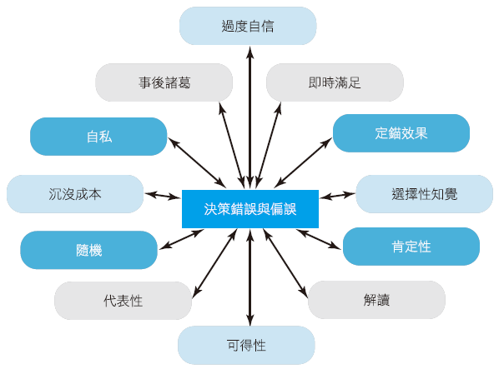

Common Decision-Making Errors and Biases
Error and Bias
4-<number>

Slide 12

Common Mistakes in the Decision-Making Process
  Decision makers often rely on “rules of thumb(經驗法則)” or heuristics (捷思) to simplify complex decisions.
    Errors and biases in processing and evaluating information
    Overconfidence bias(過度自信): Decision makers overestimate their ability to predict outcomes.
  Framing bias(解讀偏誤): Decision makers emphasize certain aspects of a situation while ignoring others, leading to distorted interpretations.
4-<number>

Slide 13
Common Mistakes in the Decision-Making Process
  Additional Common Biases
  self-serving bias(自私偏誤)
    Decision makers attribute successes to themselves (成功歸諸於自己) but blame failures on external factors.
  hindsight bias(事後諸葛偏誤)
    After an outcome is known, decision makers falsely believe they accurately predicted it all along.
4-<number>

Slide 14

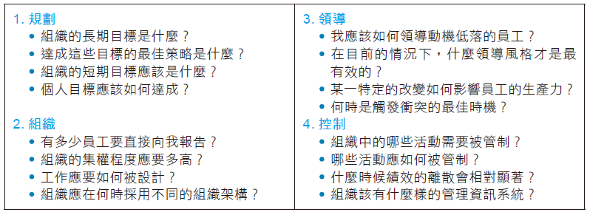
B. Three Decision-Making Approaches
Managers make decisions while planning, organizing, leading, and controlling.
Decision-Making Manager do
4-<number>

Slide 15

Three Decision-Making Approaches
rational decision making (理性決策模式)
bounded rationality (有限理性)
intuitive decision making (直覺的決策制定)
現代管理學 ch2 決策制定的基礎
4-<number>

Slide 16
Rational Decision Making
理性的假設Assumption:
  Objective (客觀) and logical (合乎邏輯)。
  Clearly defines the problem。
  Clear and specific goals。
  Knows all possible alternatives and consequences。
  Chooses the alternative that best achieves the goals
Additional assumption:
  Decisions are made in the organization’s best interest(組織的利益)
1-<number>

Slide 17
Bounded Rationality
Decision makers act rationally within the limits of their capacity.
Assumptions:
  Cannot analyze all information about every alternative
  Seek a “satisficing” solution (滿意解, good enough) rather than the best one.
Decisions are also influenced by organizational culture組織文化, internal politics內部政治, power factors權力因素, and commitment
They are continuing to invest resources in failing courses of action despite evidence of their inadequacy.
  winner’s curse(贏家的詛咒)
1-<number>

Slide 18
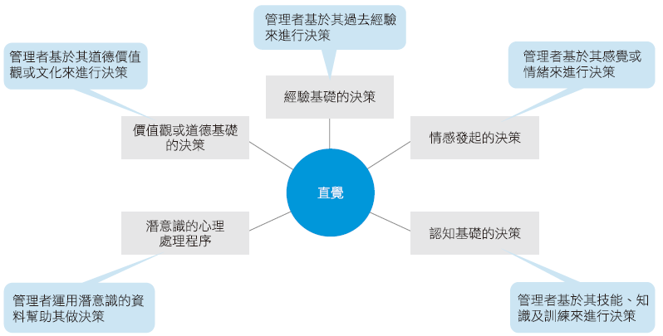
Intuitive Decision Making
A decision-making approach based on accumulated personal experience, feelings, and judgment.
1-<number>

Slide 19
Intuitive Decision Making
Guidelines for Using Intuition in Decision Making:
  Complement-not replace-other decision-making methods
  Leverage past experience with similar problems to act quickly under limited information。
  Be mindful of strong emotions and feelings that may cloud judgment。
1-<number>

Slide 20
C1. Types of Problems
How do problems differ?•
  Well-structured problems (高度結構化問題)。
  unstructured problems (非結構化問題)。
4-<number>

Slide 21
C1-1. Well-Structured Problems and Programmed Decisions
Well-structured problems
  Clear goals, Familiar situations, Easily accessible relevant information
  These are repetitive or routine situations for which established solutions already exist.
  Programmed (or routine) decisions are the most efficient way to handle well-structured problems
.
1-<number>

Slide 22
Three Types of Pre-established Systematic Responses
procedures(程序)
  A series of sequential steps used to respond to well-structured problems.
rules (規則)
  Explicit, simple statements that ensure consistency and define boundaries for action.
4-<number>

Slide 23
Decision Types and Decision-Making Conditions
policies(政策)
  Provide general guidelines or directions for thinking about decisions
Lower-level managers typically face familiar, repetitive problems and rely heavily on programmed decisions, such as standard operating procedures (SOPs, 標準作業程序).
現代管理學 ch2 決策制定的基礎
4-<number>

Slide 24
C1-2. Unstructured Problems and Nonprogrammed Decisions
Unstructured problems
  New or unusual; Ambiguous or incomplete information
Nonprogrammed decisions
  Require customized, novel solutions
1-<number>

Slide 25
How Do Nonprogrammed and Programmed Decisions Differ?
  Nonprogrammed decisions require developing new organizational strategies to craft unique solutions
.
1-<number>

Slide 26
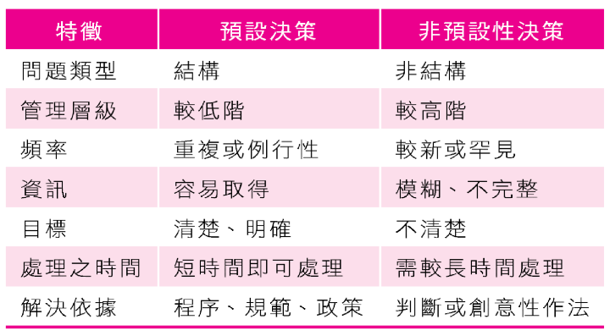
1-<number>

Slide 27
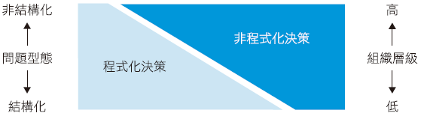
  As managers move up the organizational hierarchy, the problems they encounter tend to become less structured.
  Lower-level managers handle routine decisions and escalate unusual or complex issues upward.
4-<number>

Slide 28
C2. Decision-Making Conditions
Decision-Making Conditions
  Certainty (確定性)
  Risk(風險性)
  Uncertainty (不確定性)
4-<number>

Slide 29
Decision-Making Conditions
Certainty: All possible outcomes are known.
Risk: Outcomes are uncertain, but decision makers can estimate probabilities of success or failure for each alternative.
Uncertainty: Decision makers lack knowledge of possible outcomes or their probabilities
    Maximax (optimist): Choose the alternative with the best possible payoff.
    Maximin (pessimist): Choose the alternative with the best worst-case outcome.
    Minimize the maximum opportunity loss.
  Managers often rely on intuition, creativity, observation, and courage
1-<number>

Slide 30
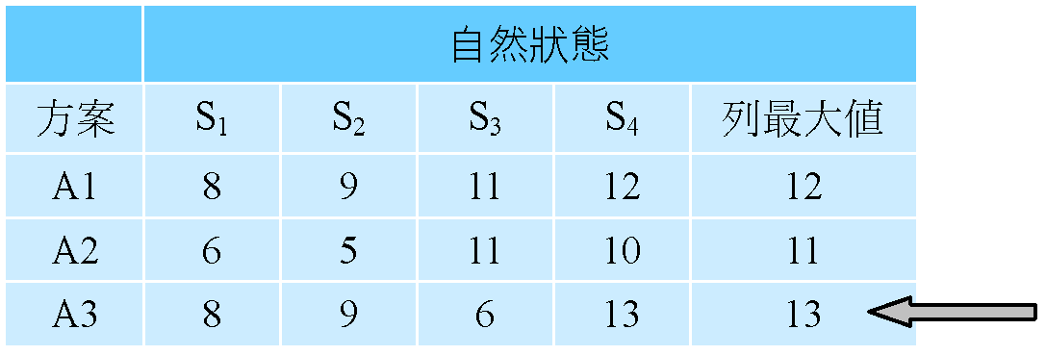
Uncertainty
Optimistic Decision Makers
    Assume the best possible outcome will occur regardless of the chosen alternative.
    They select the alternative offering the highest possible payoff (maximax criterion大中取大).
1-<number>

Slide 31
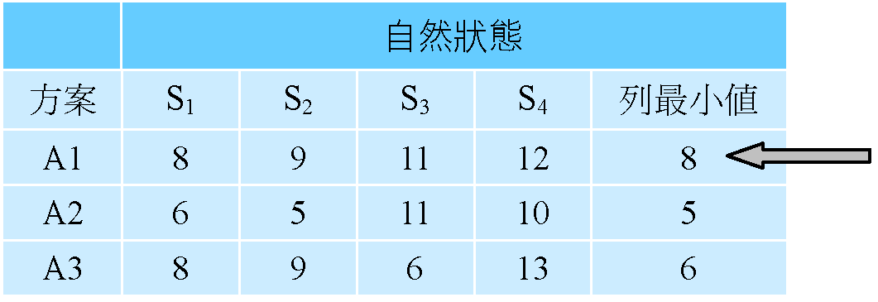
Uncertainty
Pessimistic Decision Makers
  Assume the worst possible outcome will occur.
  They evaluate the worst outcome for each alternative and select the one with the best (least bad) worst-case result (maximin小中取大criterion).
1-<number>

Slide 32
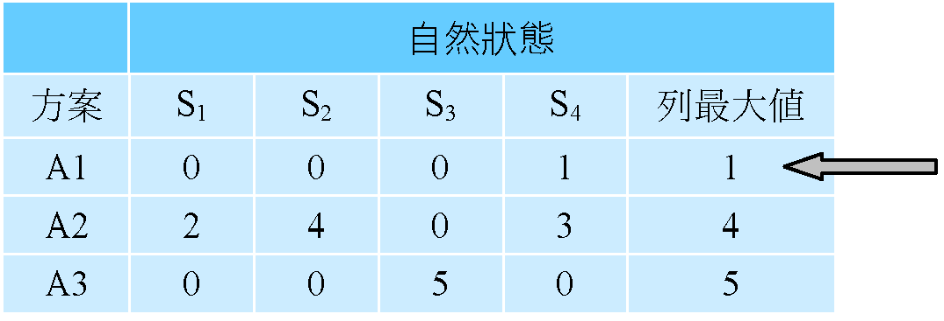
Uncertainty
Conservative (Minimax Regret) Decision Makers
  Use a regret matrix遺憾矩陣(or opportunity loss matrix機會損失) : For each state of nature, subtract each alternative’s payoff from the best payoff in that column.各欄之最大報酬減去各方案之收益, The resulting values represent regret.
  The decision maker then selects the alternative with the smallest maximum regret to minimize potential disappointment.決策者會在了解各項方案的最大機會損失後，選取具最小值的方案
8-8
8-6
8-8
1-<number>

Slide 33
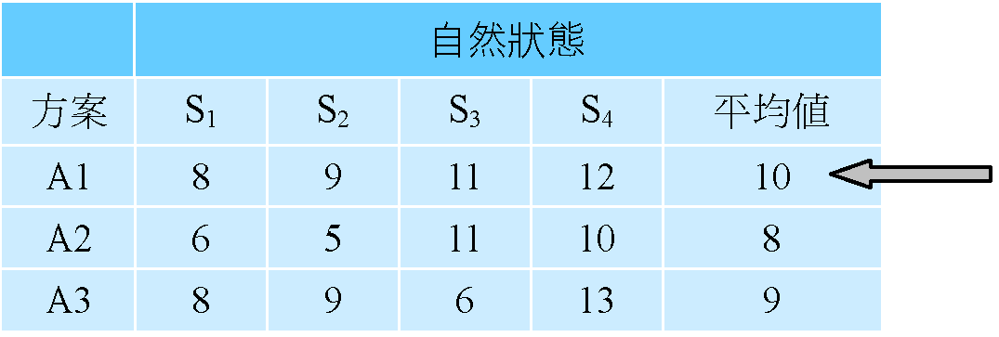
Uncertainty
Insufficient Reason (Laplace Criterion) Decision Makers
  Assume all outcomes are equally likely(發生的機率都一樣). Assign equal probabilities to each outcome and select the alternative with the highest expected value.
  This “principle of insufficient reason” is sometimes criticized as unrealistic.
1-<number>

Slide 34
C2.1 Linear vs. Nonlinear Thinking Styles
Thinking styles（思考方式） reflect two dimensions:
  Preferred sources of information:
    External data and facts (linear)
    Internal insights such as intuition (nonlinear)
  Methods of processing information:
    Linear: Rational, logical, analytical
    Nonlinear: Intuitive, creative, insightful
The four thinking traits (logical邏輯, analytical分析, creative創意, insightful洞察力) can be grouped into two styles.
1-<number>

Slide 35
Linear thinking style:
  Prefers external data and facts;
  processes information rationally and logically to make decisions and take action.
Nonlinear thinking style:
  Relies more on internal data and personal intuition;
  processes information through personal, unique methods and uses intuition to decide and act.
1-<number>

Slide 36
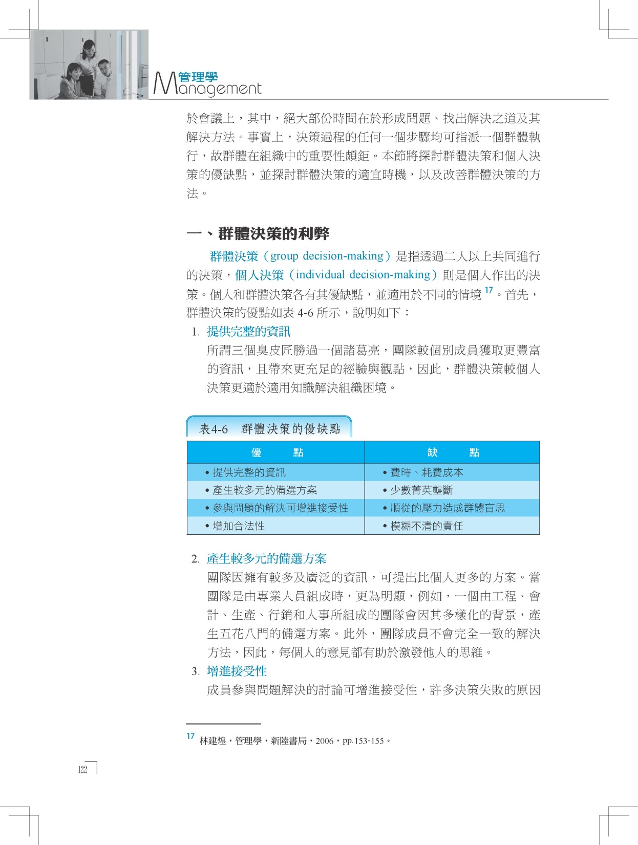
C2.2 How Do Groups Make Decisions?
Decisions are often made collectively through committees, task forces, review panels, work teams, or other group-based mechanisms.
Any of the eight steps in the decision-making process can be assigned to a group.
4-<number>

Slide 37
Advantages and Disadvantages of Group Decision Making
  Advantages over individual decision making:
    More information
    Diversity of experience and perspectives
    Generation of more alternatives
    Higher acceptance of the final decision among those affected or responsible for implementation
    Legitimacy(正當性)—individual decisions may appear autocratic or dictatorial
4-<number>

Slide 38
Advantages and Disadvantages of Group Decision Making
Disadvantages of Group Decision Making:
  Time-consuming
  Risk of minority domination
  Ambiguous accountability
  Pressure to conform
Groupthink(群體迷思): A form of conformity where minority, or unpopular views are suppressed to achieve consensus.
4-<number>

Slide 39
Advantages and Disadvantages of Group Decision Making
When Is Group Decision Making Most Effective?
  Effectiveness depends on group size。
  Optimal group size ranges from 5 to 15 members, with 5–7 being most effective—odd numbers help avoid decision deadlocks.
4-<number>

Slide 40
Group Decision Making
Enhancing Creativity in Group Decision Making: Three techniques to boost group creativity:
  Brainstorming(腦力激盪)
    Encourages generation of all possible alternatives
  Nominal group technique (名目群體技術)
    Limits discussion during the decision process to arrive at a preferred solution.
  Electronic meetings:
    Anonymity(匿名性), honesty(誠實), and speed(速度).
    video conference (視訊會議)。
4-<number>

Slide 41
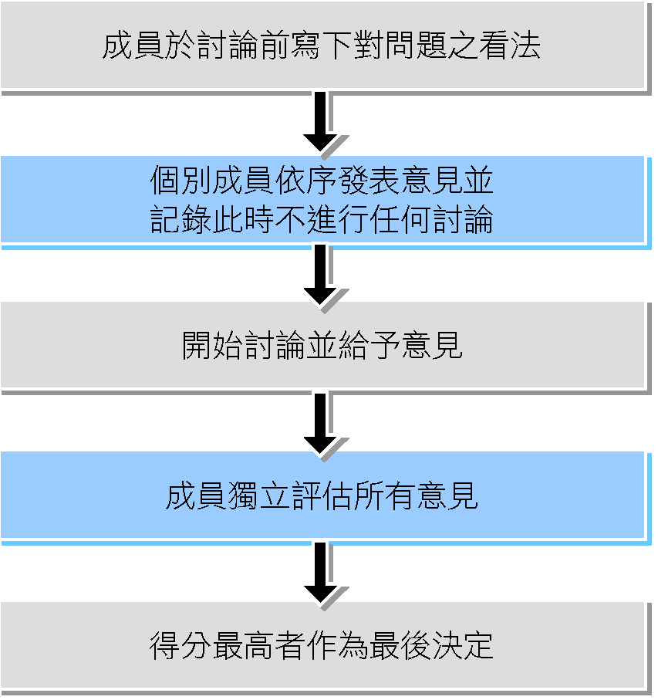
名目群體技術進行的步驟
現代管理學 ch1 管理者與管理
1-<number>

Slide 42
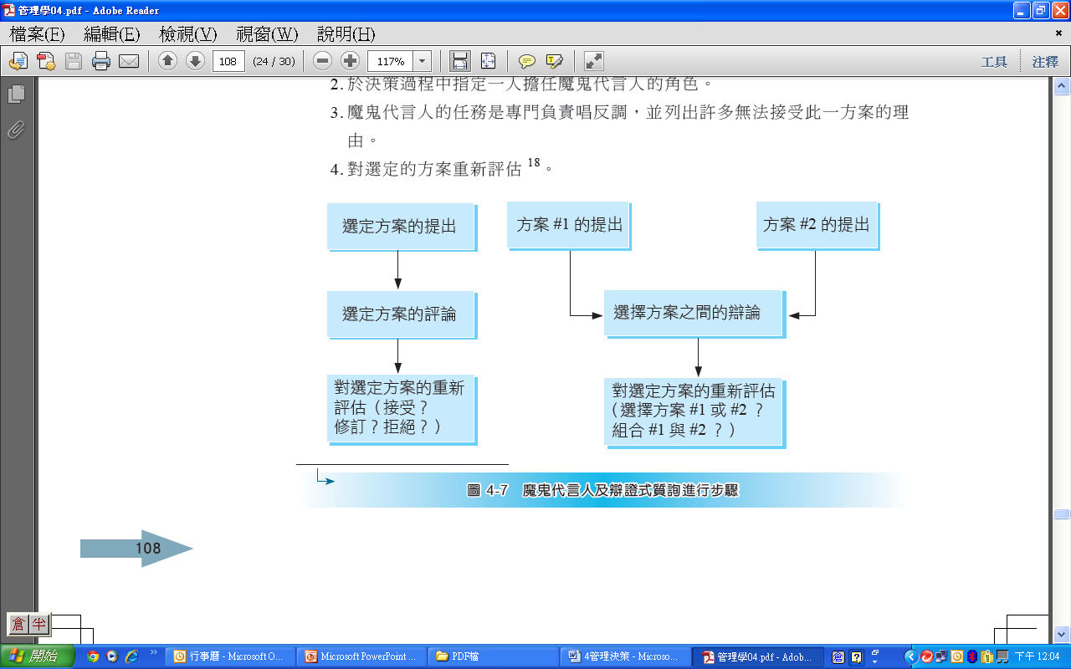
Group Decision Making
Devil’s Advocacy
  Assign one member to play the “devil’s advocate。
  deliberately challenging the proposal and listing reasons it might fail
  Repeated critique leads to a stronger final decision.
1-<number>

Slide 43
Group Decision Making
Stepladder technique（階梯技術法）
  Gradually adds members to reduce groupthink。其該技術的步驟與特色如下：
    Two members (A and B) independently develop and discuss solutions to reach a shared answer。
    A third member (C), who has independently studied the problem, joins to reach a three-person consensus
    A fourth member (D), also prepared independently, joins the group.–
    Final decision emerges from the four-member consensus
1-<number>

Slide 44
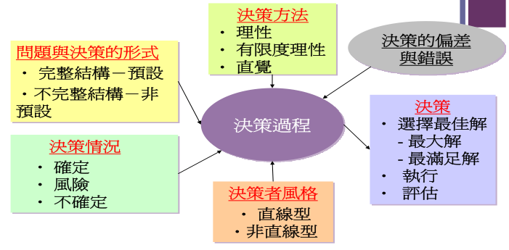
Group Decision Making
1-<number>

Slide 45
D. Contemporary Issues in Managerial Decision Making
How National Culture Influences Managerial Decision Making
    Decision-making practices vary across countries.
    In high power distance and high uncertainty avoidance cultures (e.g., China and India), only top-level managers typically make decisions, often favoring safe, conservative choices.
    When managing diverse cultural teams, managers must clarify which decision-making behaviors are acceptable.
4-<number>

Slide 46
Contemporary Issues in Managerial Decision Making
Creativity and Design Thinking
  Understanding Creativity:
    Decision makers need creativity(創造力) to fully understand problems and to generate novel alternatives
    The three-component model of creativity suggests that individual creativity requires:• Expertise(專業)• Creative-thinking skills(創意思考的技巧)• Intrinsic task motivation(內在任務動機).
4-<number>

Slide 47
Contemporary Issues in Managerial Decision Making
  Big data
    Big data refers to massive volumes of information that can be analyzed using data-processing tools.。
    An IT expert describes big data using the “4 Vs”: high Volume, high Velocity, and/or high Variety of information assets to create the Value.
    Big data provides decision makers with powerful tools to enhance decision quality.
4-<number>

